Slide 1
GUI
TKINTER
GUI
INTRODUCTION
SPELL
CORRECTOR
TEXTBLOB
“SPELL CORRECTOR GUI USING TKINTER”
A spell corrector GUI is a Graphical User Interface that allows users
to check the spelling of a piece of Text and correct any spelling errors.
It is useful tool for improving the accuracy and readability of written
documents,socialmedia,posts and other types of text. In this Python
project we have Built a spell checker and corrector that can take input
word and produce a term that sounds close to it.
A Goal of “Spell corrector” is to identify terms that are
Similar to a word that is entered. A list of terms that most closely
resemble the input word is shown by a spell corrector entry box.
*

Slide 2
ARCHITECTURE
Steps followed to develop the python spell corrector GUI:
We imported the TextBlob and Tkinter modules first.
Next, we developed the GUI and incorporate the necessary widgets.
Finally, we created the function that verifies the spelling and outputs
for appropriate results.

Slide 3
Prerequisites of the Project
In this spell corrector python programme we have utilized the python TextBlob
and Tkinter libraries to develop this project. The GUI for gathering the user’s
Input and displaying the output depending on the entered spelling is built using
Tkinter module. And used the TextBlob module to do this check.
The Tkinter and the TextBlob modules were imported from standard python Library to
be used in our code. Tkinter module is used for creating the GUI window and adding
Widgets to our application and the TextBlob module is taken for correcting the incorrect
word provided by user.

Slide 4
BUILT-IN METHODS
1.Tk( ):This method is used to create a main window for the GUI application. It
takes no arguments and returns a window object.
2.title( ): This method is used to set the title of the window. It takes a string argument
returns none.
3. geometry( ):This method is used to set the size of the window. It takes a string argument
in the form ‘width x height’ and returns none.
4.config(): This method is used to configure the properties of the window. It takes keyword
arguments corresponding to the properties to be set and returns none.
5. focus(): This method is used to set the focus on the entry field. It takes no arguments
and returns none.
6.pack(): This method is used to arrange the widgets in the window. It takes optional keyword
arguments corresponding to the widget placement and returns none.
7.place(): This method is used to place the widgets at specific position in the window. It takes
keyword arguments corresponding to widget position and returns none.

Slide 5
8. mainloop( ): This method used to start the event loop of the GUI application. It takes no argument and returns none.

Slide 6
IMPLEMENTATION
# import the necessary libraries
import tkinter
from tkinter import*
from textblob import TextBlob
# create the main window
root=Tk( )
# set the title of the window
root.title("SPELLING CORRECTOR")
# set the size of the window
root.geometry("700x400")
# set the background color of the window
root.config(background="#dae6f6")
# define the function to correct the spelling of the input word
def check_spelling( ):
# get the input word
word=enter_text.get( )
# create a TextBlob object with the input word
a=TextBlob(word)
# correct the spelling of the input word using the correct() method of the TextBlob object
right=str(a.correct( ))

Slide 7
# create a label to display the corrected text
cs=Label(root,text="corrected text is:",font=("poppins",20),bg="#dae6f6",fg="#364971")
# place the label at a specific position in the window
cs.place(x=100,y=250)
# set the text of the label widget to the corrected word
spell.config(text=right)
# create a heading label
heading=Label(root,text="SPELLING CHECKER",font=("trebuchet ms",30,"bold"),bg="#dae6f6",fg="#364971")
# place the heading label in the window using the pack() method
heading.pack(pady=(50,0))
# create an entry field to take the input
enter_text=Entry(root,justify="center",width=30,font=("poppins",25),bg="white",border=2)
# place the entry field in the window using the pack() method
enter_text.pack(pady=10)
# set the focus on the entry field
enter_text.focus()
# create a button to perform the spelling correction
button=Button(root,text="check",font=("arial",20,"bold"),fg="white",bg="red",command=check_spelling)

Slide 8
# place the button in the window using the pack() method
button.pack()
# create a label widget to display the corrected word
spell=Label(root,font=("poppins",20),bg="#dae6f6",fg="#364971")
# place the label widget at a specific position in the window
spell.place(x=350,y=250)
# start the event loop of the GUI application
root.mainloop()

Slide 9
COMPLETE CODE
import tkinter
from tkinter import*
from textblob import TextBlob
root=Tk( )
root.title ("Spellimg Corrector")
root.geometry ("700x400")
root.config (background="#dae6f6")
def check_spelling( ):
word=enter_text.get( )
a=TextBlob(word)
right=str(a.correct())
cs=Label(root,text="corrected text is:",font=("poppins",20),bg="#dae6f6",fg="#364971")
cs.place(x=100,y=250)
spell.config(text=right)
heading=Label (root,text="SPELLING CHECKER",font=("trebuchet ms",30,"bold"),bg="#dae6f6 ",fg="#364971")
heading.pack(pady=(50,0))
enter_text=Entry(root,justify="center",width=30,font=("poppins",25),bg="white",border=2)
enter_text.pack(pady=10)
enter_text.focus( )
button=Button(root,text="check",font=("arial",20,"bold"),fg="white",bg="red",command=check_ spelling)
button.pack( )
spell=Label(root,font=("poppins",20),bg="#dae6f6",fg="#364971")
spell.place(x=350,y=250)
root.mainloop( )

Slide 10
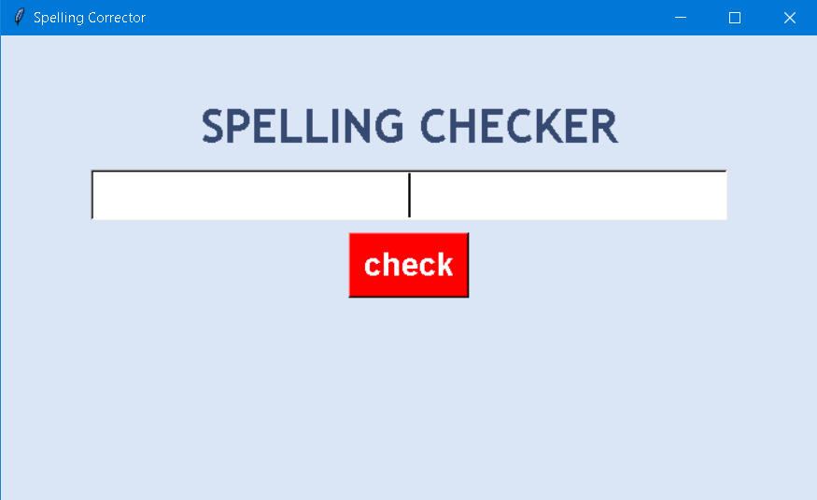
RESULTS
The screenshots of output of the above created Spell Corrector Application are
attached below.

Slide 11
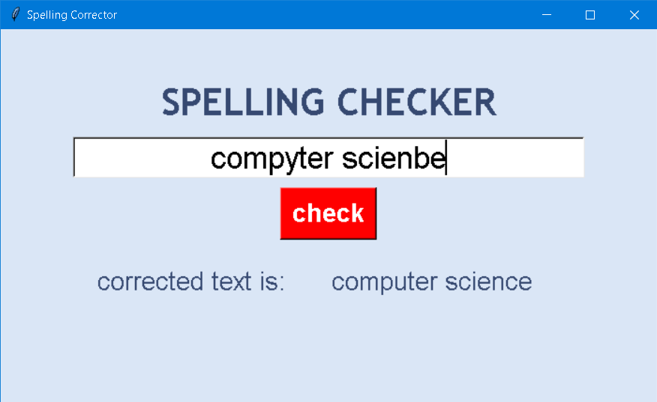
2. View of the window after we enter a word and click on check
button

Slide 12
THANK YOU

